Slide 1
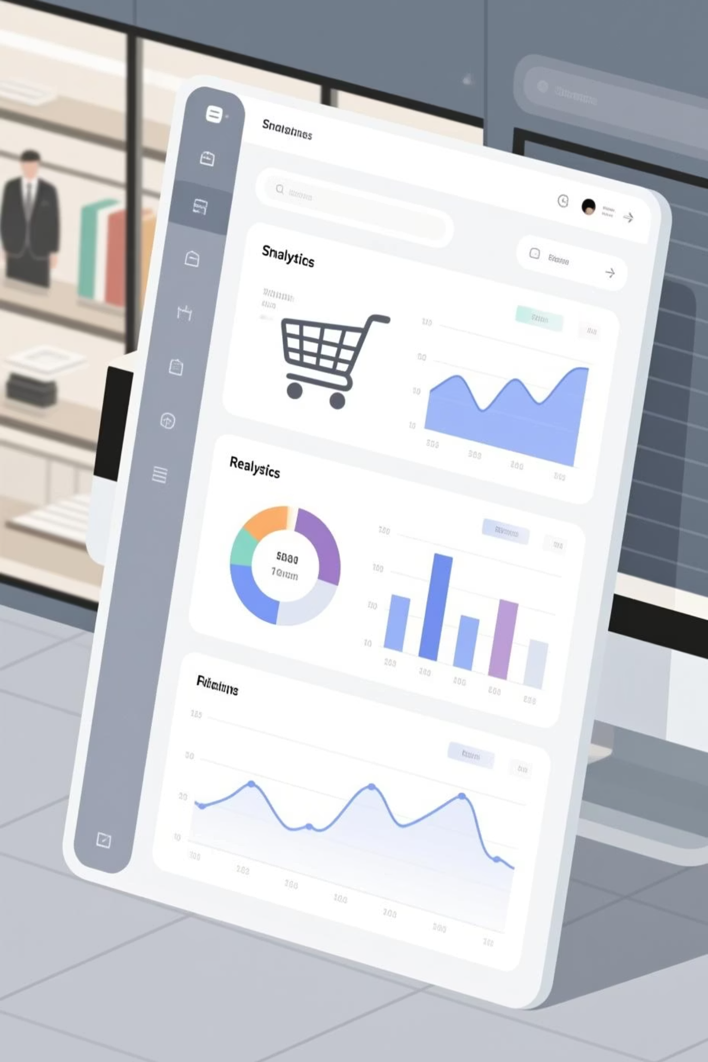

Customer Shopping Behavior Analysis
Uncovering insights from 3,900 purchases to drive strategic business decisions

Slide 2

Dataset at a Glance
3,900
18
25
50
Total Purchases
Data Points
Product Types
Locations
Transactions analyzed across all categories
Features tracking demographics and behavior
Items across 4 major categories
Geographic distribution of customers

Slide 3

Data Preparation Journey
01
Data Loading & Exploration
Imported dataset using pandas, analyzed structure with df.info() and summary statistics
02
Cleaning & Standardization
Handled 37 missing review ratings, standardized columns to snake_case format
03
Feature Engineering
Created age_group bins and purchase_frequency_days for deeper analysis
04
Database Integration
Connected to PostgreSQL for advanced SQL querying and business insights

Slide 4
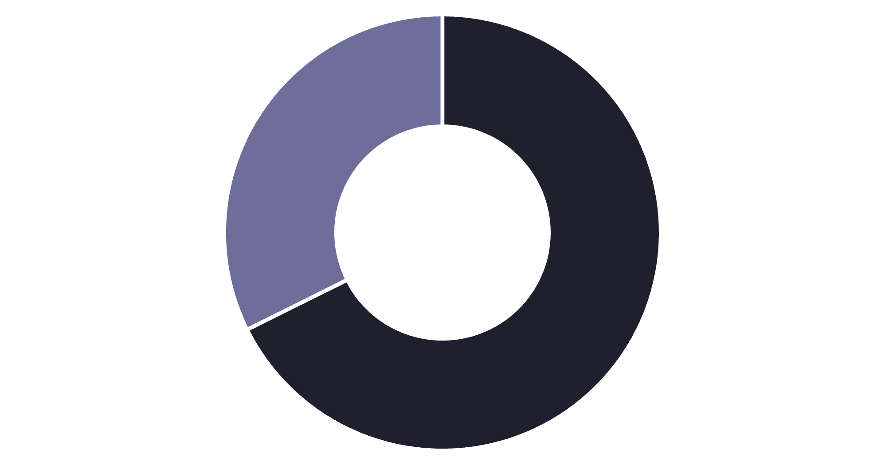
Revenue by Gender
Male Customers Drive Revenue
Male shoppers generate 68% of total revenue, more than double female contribution
Strategic opportunity to boost female customer engagement
Male
Female

Slide 5





Top-Rated Products
Gloves
Sandals
Boots
3.86 rating
3.84 rating
3.82 rating
Hat
Skirt
3.80 rating
3.78 rating

Slide 6


Shipping Insights
Standard Shipping
Express Shipping
$58.46 average purchase
$60.48 average purchase
Express shipping customers spend 3.5% more per transaction

Slide 7



Subscription Status Comparison
Subscribers
Non-Subscribers
1,053 customers (27%)
2,847 customers (73%)
$59.49 average spend
$59.87 average spend
$62,645 total revenue
$170,436 total revenue
Similar spending patterns suggest subscription benefits need stronger differentiation

Slide 8



Customer Segmentation
New
1
83 customers
Returning
2
701 customers
Loyal
3
3,116 customers
80% of customers are loyal repeat buyers - strong retention foundation

Slide 9
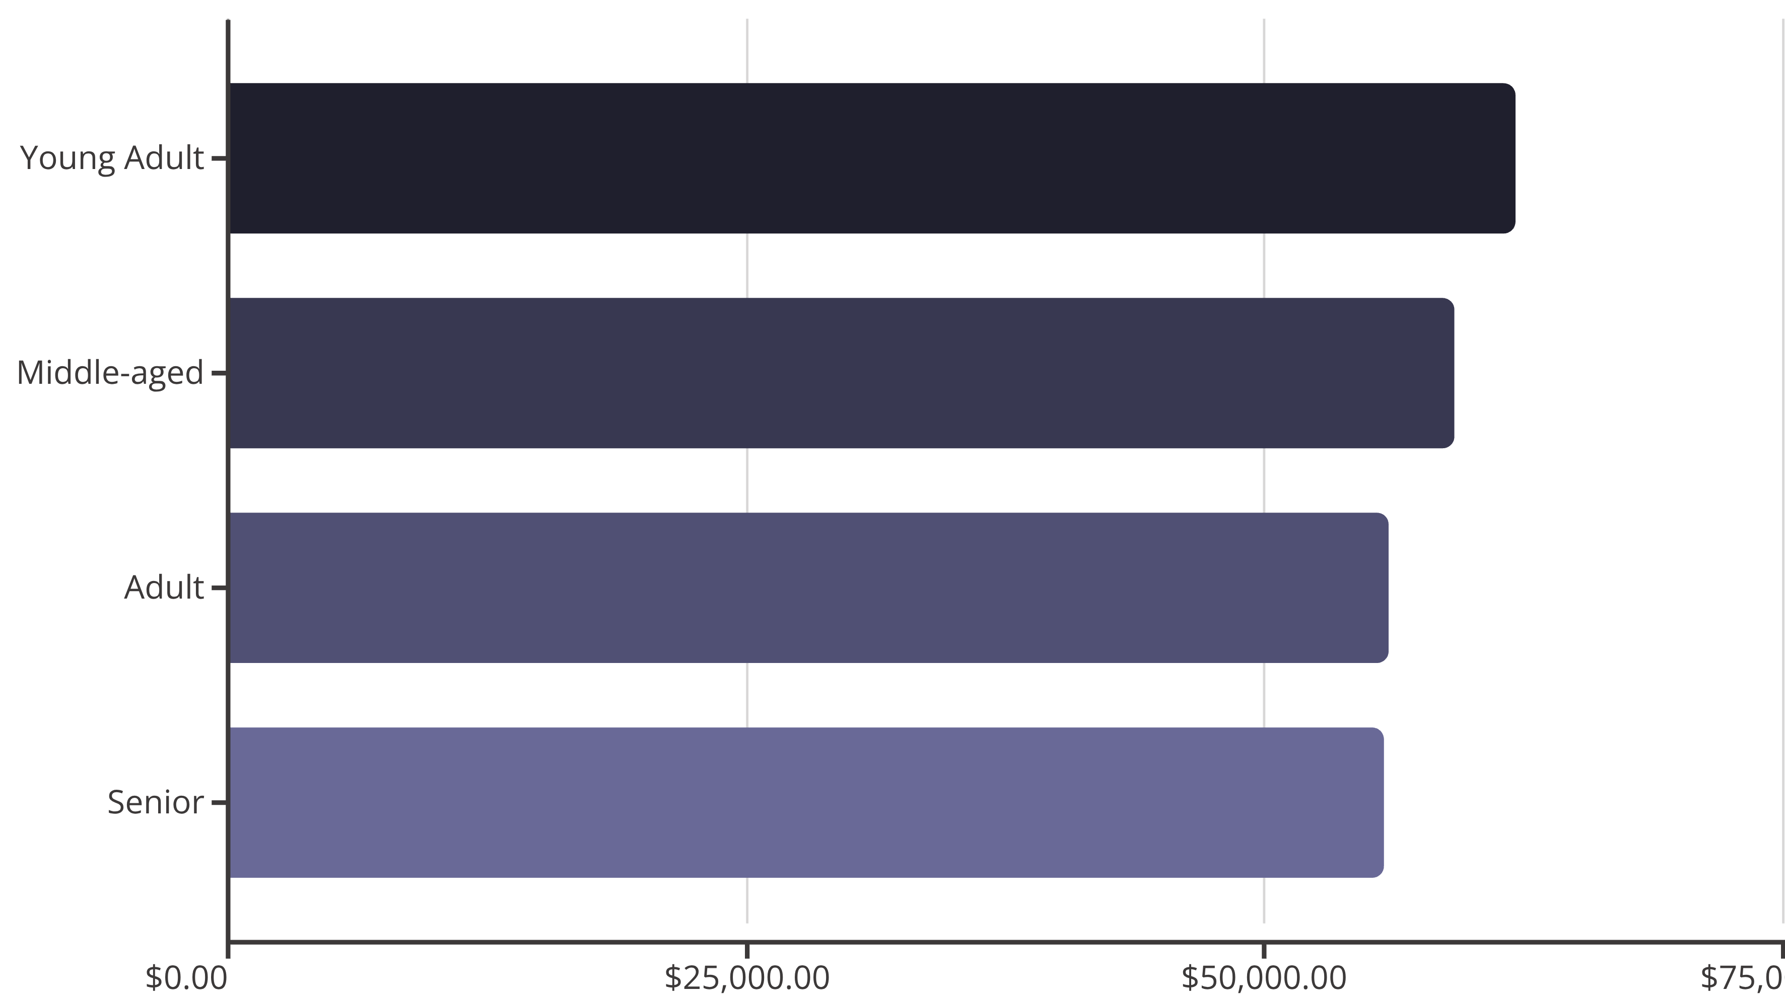
Revenue by Age Group
Young adults lead revenue generation, but all segments show balanced contribution

Slide 10
Strategic Recommendations
Boost Subscriptions
Loyalty Programs
Review Discounts
Targeted Marketing
Promote exclusive benefits to convert non-subscribers
Reward repeat buyers to strengthen retention
Balance sales boosts with margin control
Focus on high-revenue segments and express shipping users

